Slide 1






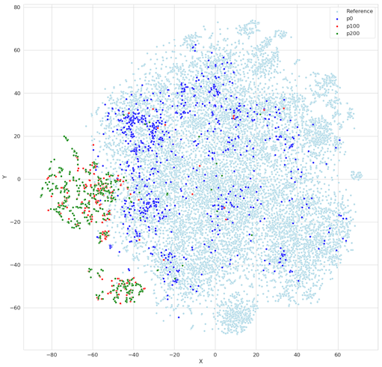
Authors
Affiliations
Accelerating Therapeutics for Opportunities in Medicine (Cancer Research)
ATOM Pipeline
Model and Data Clearinghouse (MoDaC)
Molecular data library - Open curated and model-ready database
2. AMPL
Shared Space
Data Services API Core
Web Application
Transferability
User Database
Transfer
Endpoints
Distributed collaborative public facing web application
Data Management
and Transfer
Configurable access levels
3. GMD
Metadata Server
Globus
Metadata Store
Data
Local
Object Repository
Github: https://github.com/ATOMconsortium/AMPL
AI and computing-driven molecular discovery and optimization
AMPL Pipeline
GMD Pilot Project - Neurocrine H1 Design
3. GMD - A high-performance platform for parallel optimization of efficacy, safety, and pharmacokinetics
Example – GMD Pilot design projects in cancer, infectious disease and other areas;
chemical space covered by initial compounds (dark blue) and molecule populations in generations 100 (red) and 200 (green) of GMD run.
Data Ingestion + Curation
Model Training + Tuning
Featurization
Prediction Generation
Visualization + Analysis
Data Lake
Model Zoo
Results DB
2. AMPL (ATOM Modeling PlpeLine) –
Predictive modeling: training, optimization, and property prediction
atomscience.org | @ATOM_consortium | #ATOMscience

